Slide 1
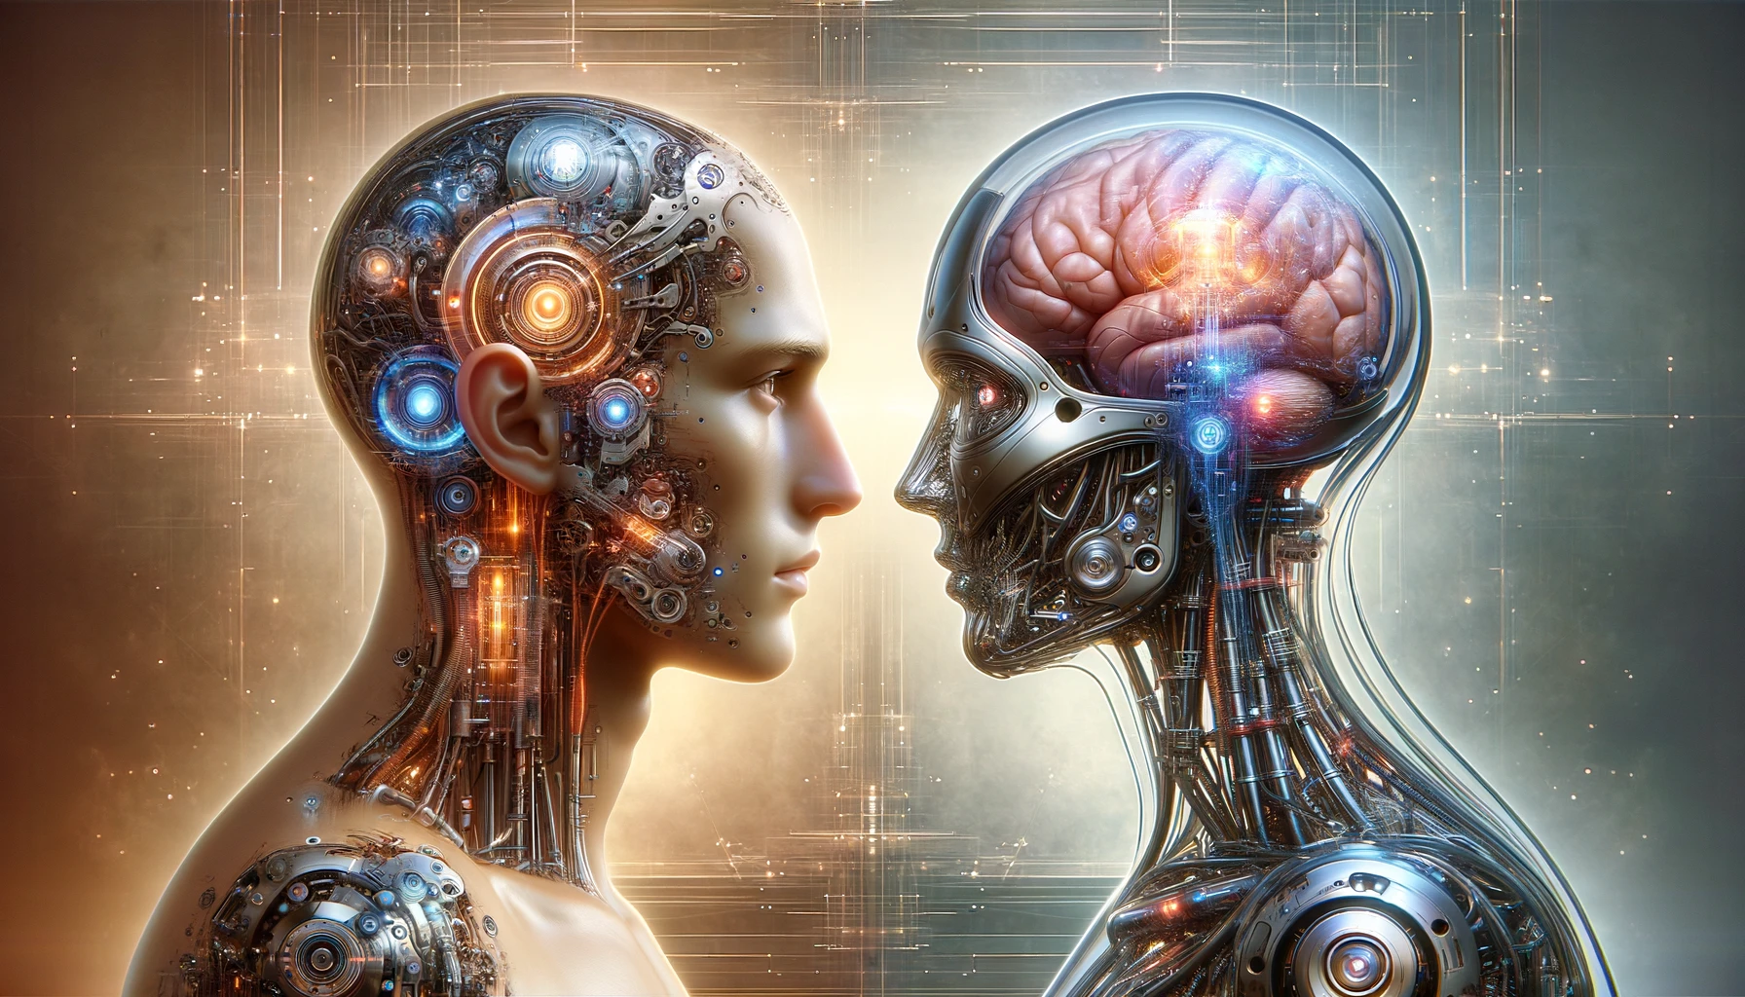
Humans as AI, AI as Humans
Notes:
Good afternoon everyone. Today, I’d like to talk about my final project, Humans as AI, AI as Humans.

Slide 2
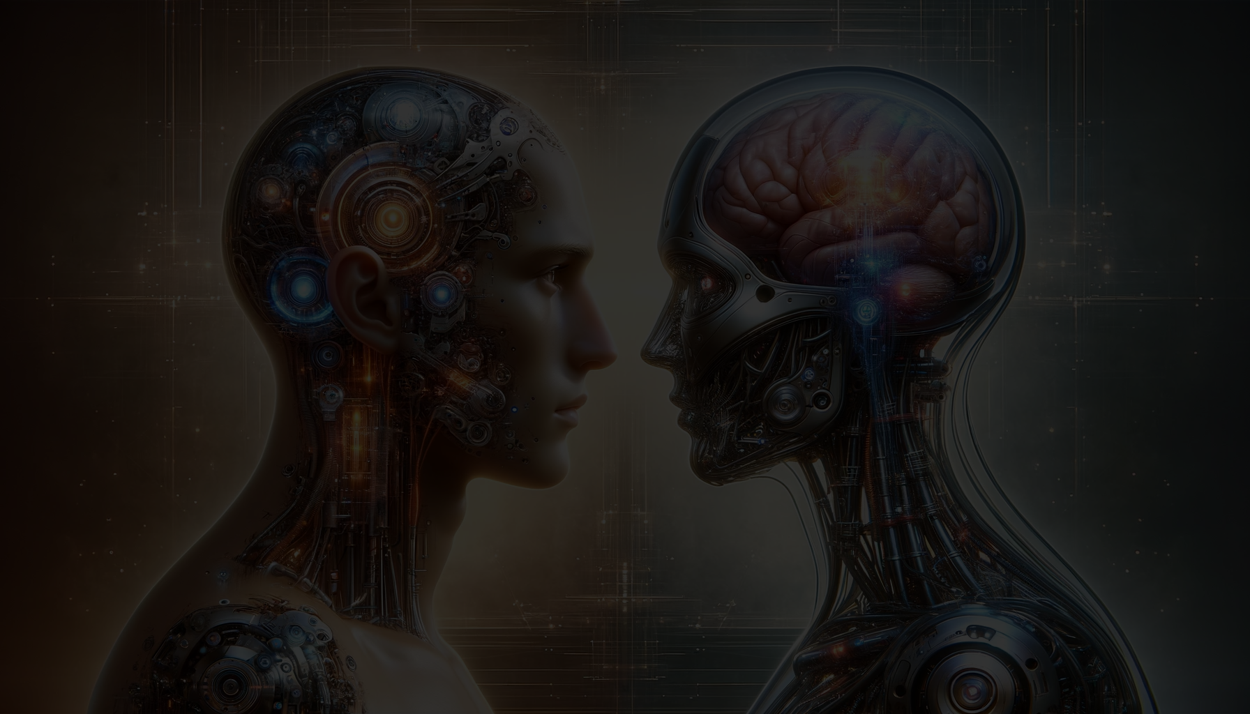
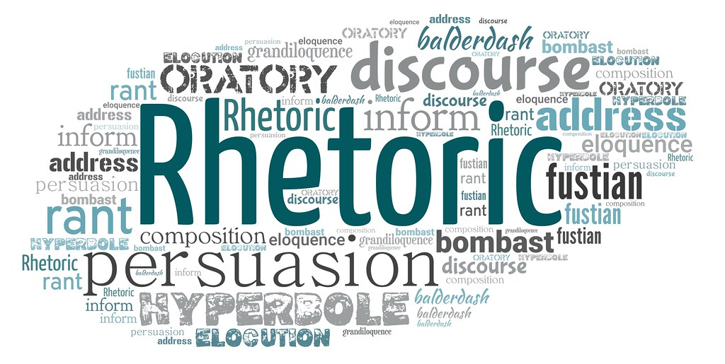
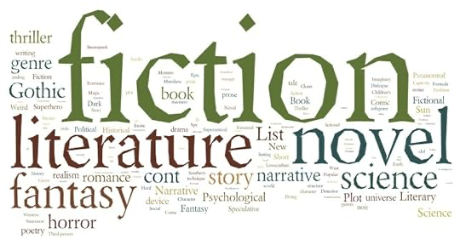
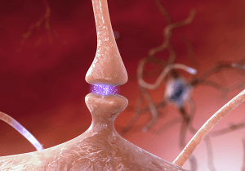
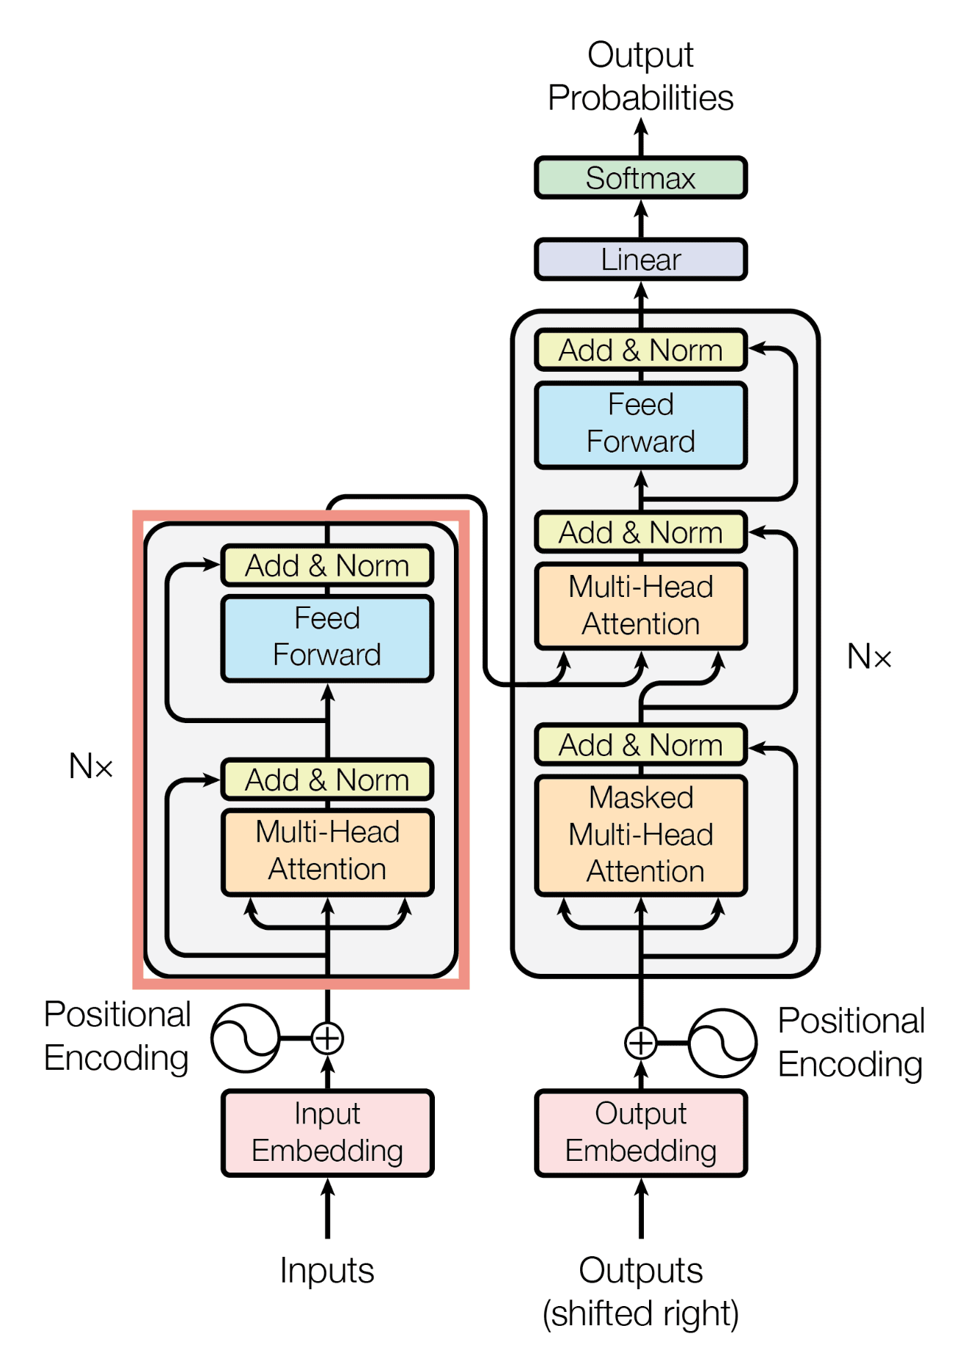
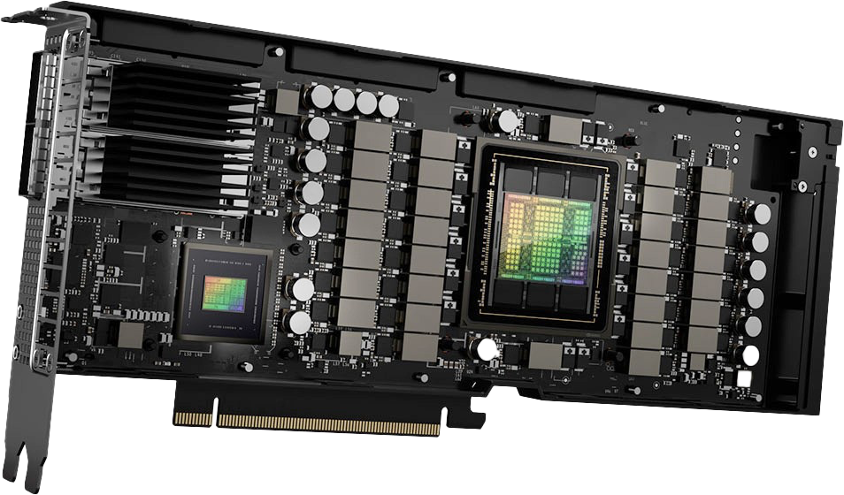
Complex
Human language
AI’s language
Fundamental, simple
Notes:
Here, we have human language on the left and AI’s language on the right. The y-axis represents the complexity of systems, so if you go from the bottom to the top, the systems get more complicated. The languages of both humans and AI start from the fundamental architectures like the synapses and the language model architecture, and as they get more complex, the ability to speak and write emerges as an emergent property.

Slide 3
Complex
Human language
AI’s language
?
Discussed (not good)
?
Fundamental, simple
Notes:
However, the discussion surrounding human language and AI-generated language often lacks a balanced and integrated approach. While we only tend to analyze human language as a result of complex systems, we only focus on the fundamental architectures of AI to analyze AI-generated text. This is like, when discussing the difference between Korean and English, you look at the literature written in Korean to analyze the Korean language while you only look at the alphabet of English to analyze the English language.

Slide 4
Complex
Human language
AI’s language
?
HSS319
?
Fundamental, simple
Notes:
And, as you might have realized, in this course, we have had many discussions treating both humans and AI models as a writer. This has allowed us to see various aspects of AI models as a writer which we couldn’t see with the traditional approaches.

Slide 5
Complex
Human language
AI’s language
?
Q2
?
Q1
Fundamental, simple
Notes:
And for my project, I am going to discuss human language and AI language on both fundamental and complex scales. The premise here is that a comprehensive understanding of the foundational mechanisms of both is essential for expanding our discussion topic to the discussions about their complex linguistic capacities.

Slide 6
Complex
Human language
AI’s language
Q1. From the perspective of AI, how do humans speak and write?
?
Q2
?
Q1
Fundamental, simple
Notes:
And For my project, I am going to discuss human language and AI language on both fundamental and complex scales. The premise here is that a comprehensive understanding of the foundational mechanisms of both is essential for expanding our discussion topic to the discussions about their complex linguistic capacities.

Slide 7
Q1. From the perspective of AI, how do humans speak and write?
Language Model (Transformer Model)
Dataset (Text)
Tokenized
Context
Model Parameters
Human (Atkinson-Shiffrin Memory Model)
Input
Sensory Memory
Short Term Memory
Long Term Memory
Notes:
To answer the question, I mainly focused on the concept of memory / as memory is the most crucial part when it comes to speaking and writing. For AI, I looked at how AI models are trained to store memories and how they generate text with the memories, based on the transformer model, and for humans, I examined the Atkinson-Shiffrin memory model, which explains how memory is processed in the brain, as illustrated in the figure.

Slide 8
Q1. From the perspective of AI, how do humans speak and write?
Language Model (Transformer Model)
Dataset (Text)
Tokenized
Context
Model Parameters
Human (Atkinson-Shiffrin Memory Model)
Input
Sensory Memory
Short Term Memory
Long Term Memory
Notes:
Surprisingly, they work in almost the same way. For AI models, text is first converted into tokens, which AI models can understand, and it’s again converted into context by a mechanism called attention. The same goes for human brains, in the sense that the environmental input is converted into sensory memory and it’s converted again into short-term memory by a mechanism with the same name, attention. On the right, we have model parameters and long-term memory. They are the same in the sense that they store information indefinitely and they are not temporary as they are engraved into the model and the brain, respectively. In the end, I came up with some explanations of why AI and humans write in a different way, and also proposed a new model that encompasses both the human brain and AI models.

Slide 9
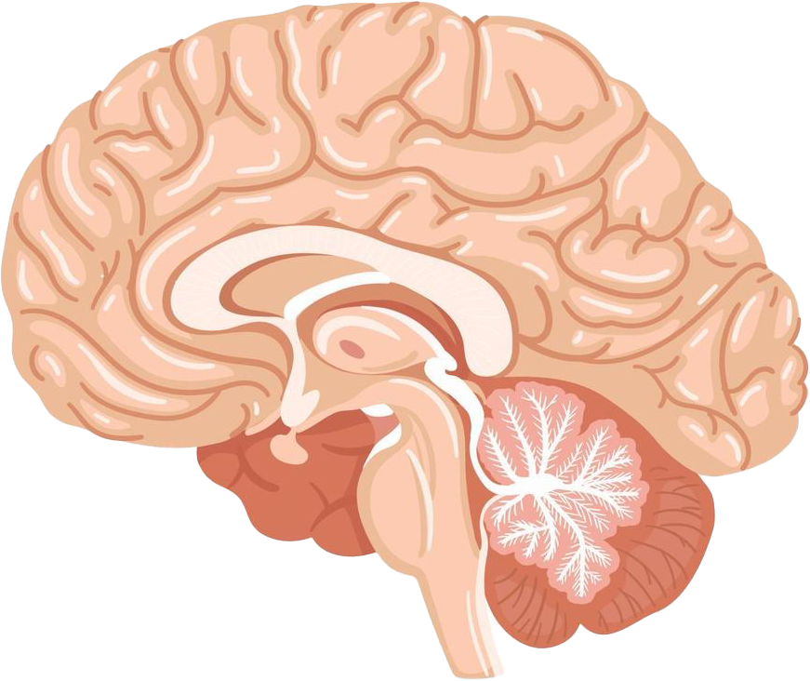
Complex
Human language
AI’s language
?
Q2
Q2. From the perspective of humans, how does AI generate text?
?
Q1
Fundamental, simple
Notes:
For the second question “From the perspective of humans, how does AI generate text?” I am going to set out my own logical argument treating AI models as a writer, similar to what we’ve done in this course.

Slide 10


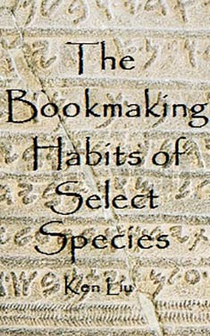

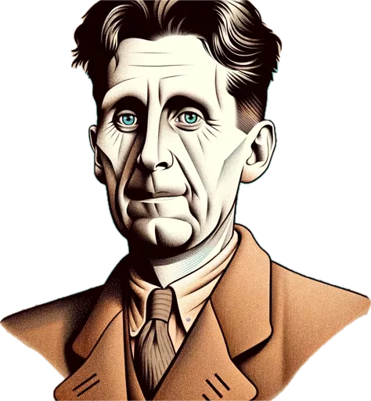
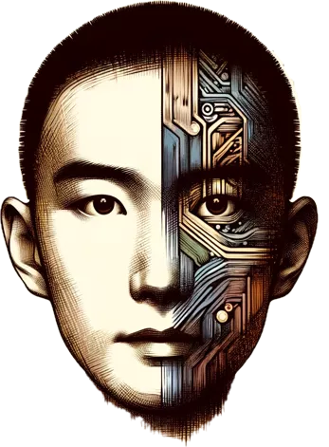
Q2. From the perspective of humans, how does AI generate text?
Story of Your Life
Why I Write
The Bookmaking Habits
of Selected Species
Notes:
To expand the scale of the discussions of AI models, I am going to project AI models onto new dimensions provided by these novels and essays. This allows us to abandon the details that we don’t need when discussing on a complex scale / and focus on the emergent properties of AI models as a writer. Also, for this question, I created my co-authors, Mr. Heptapod, Orwell’s thoughts, and Liu’s thoughts, on ChatGPT

Slide 11
Q2. From the perspective of humans, how does AI generate text?
Story of Your Life
AI’s language from the perspective of Heptapods
Notes:
For Story of Your Life written by Ted Chiang, where the difference between human language and Heptapod B is discussed, I added language models as another existence in the novel and discussed how they speak in comparison with human language and Heptapod B. And because I am not a Heptapod, Mr Heptapod shared his thoughts about human language and AI’s language.

Slide 12
Q2. From the perspective of humans, how does AI generate text?
Why I Respond (2023)
Why I Write
Notes:
For George Orwell’s Why I Write, I had Orwell’s Thoughts write its own version of Why I Write, and it actually wrote an essay and named it Why I Respond. With this essay, I am going to discuss whether it’s right to say ChatGPT indeed has reasons to respond, or it’s just programmed to respond.

Slide 13
Q2. From the perspective of humans, how does AI generate text?
The bookmaking Habits of Lexiconians (2023)
The Bookmaking Habits of
Select Species
Notes:
Lastly, for The Bookmaking Habits of Selected Species by Liu, the AI models were added to the novel as another species, named Lexiconians, and their writing habits were discussed with the help of Liu’s Thoughts. This is an attempt to see language models not only as the sum of writers but as a society.

Slide 14
Thank You!
https://www.llm-vs-human.com
Notes:
This is the end of the presentation, and if you are interested in this project, I uploaded the most recent version of my final report on this webpage so that you can check it out. Thank you for listening!

